Slide 1




Business Insight 360
By: Sahil Sachin Sarvade

Slide 2





Agenda
Company Background and Business model
The Problem Statement
Insights & Recommendation
Data Modelling
Dashboard Walkthrough

Slide 3







Customers
Consumers
AtliQ Hardware

Slide 4


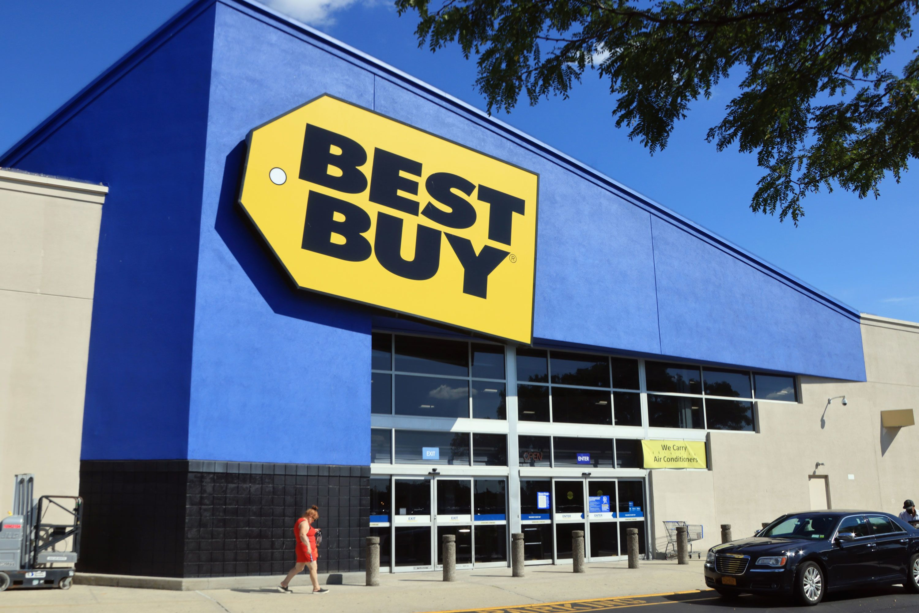

Platforms
Brick and Mortar
E- commerce

Slide 5
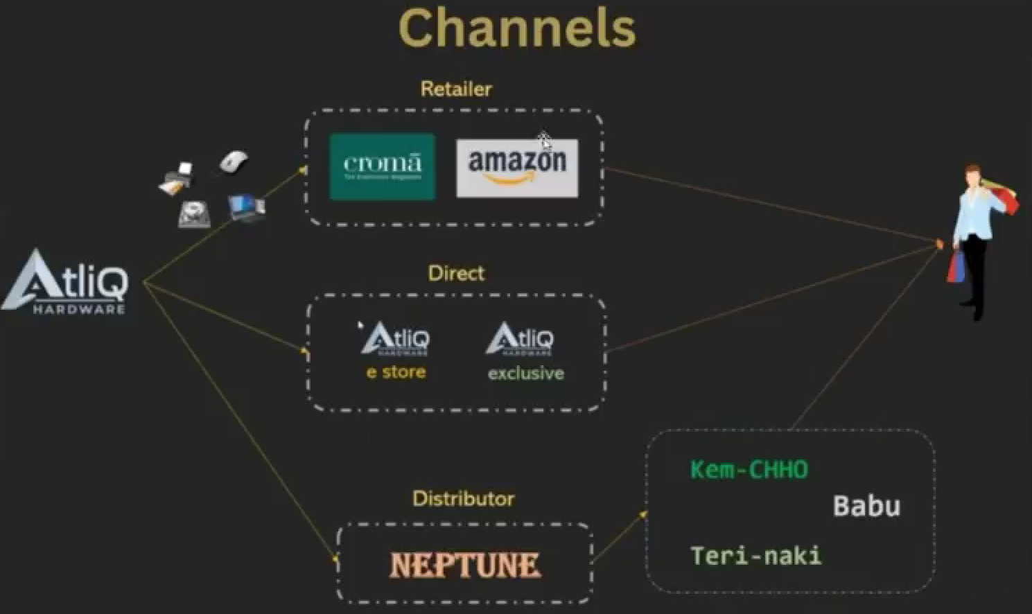

Slide 6








Problem Statement Breakdown :-
Fastest Growing Company
Bitter Experiences
In Latin America
Faced Huge Loss
Decisions on Surveys & Intuition
Better Alternatives & Improvements
Onboarding Data Analytics
Potential Solution
Success

Slide 7
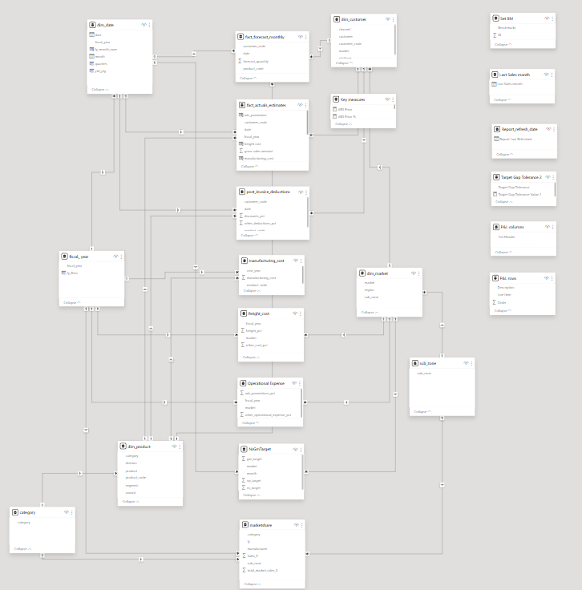
Data Model Bird Eye View
Established one to many relationship between Tables.
Consists of Fact and Dimension tables
Data Model Following a blend of Star and Snowflake Schema
Connection established between relevant columns of fact and dimension tables
Data Source Includes My SQL database , Excel and csv files.

Slide 8
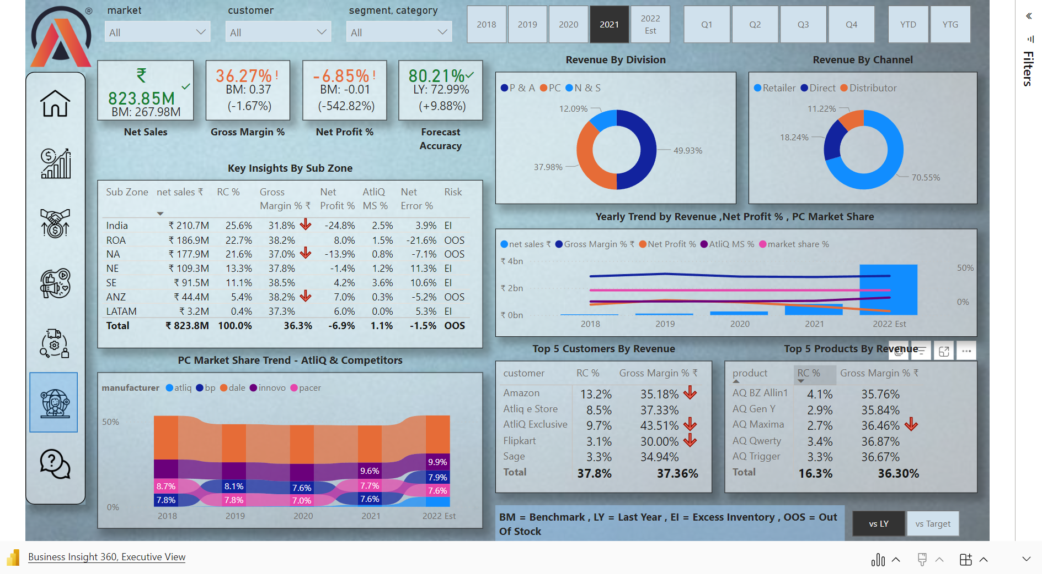

Slide 9
Insights
Recommendation
Exceptional growth in net sales with a revenue generation of ₹3.47Bn
Decline in gross margin % from Dec 2019 to march 2020 Due to covid-19 pandemic
Amazon(₹496.9 M),AtliQ E-store(₹361.1 M) and AtliQ Exclusive(₹304.1 M) are the top 3 customers for Fy. 2022
Most Items Sold for Segment of Notebooks( Gaming ,Business and Personal laptop)
GM% for Wifi Extenders – 38.25%
LATAM ----> least Sales Vol.
APAC ----> Highest sales vol.
Top markets (India , South Korea , China ).
Rise in Operational expense due to expansion
Steady Forecast Accuracy in range of 80-87
Adapt Strategies to increase the Net Profit%
A deep root cause analysis needed in LATAM to Understand the Market , locations and Customer Purchasing Behaviour.
Continue the evaluation of the financial metrics
Discard and Discontinue products that are not selling well.
Optimization needed in operational expense.
Boost sales through Digital marketing , running promotions and Ads ,Coming up with discount and offers for Consumers.
Cross Team Collaboration for effective Planning and resource Utilization.

Slide 10


